Slide 1
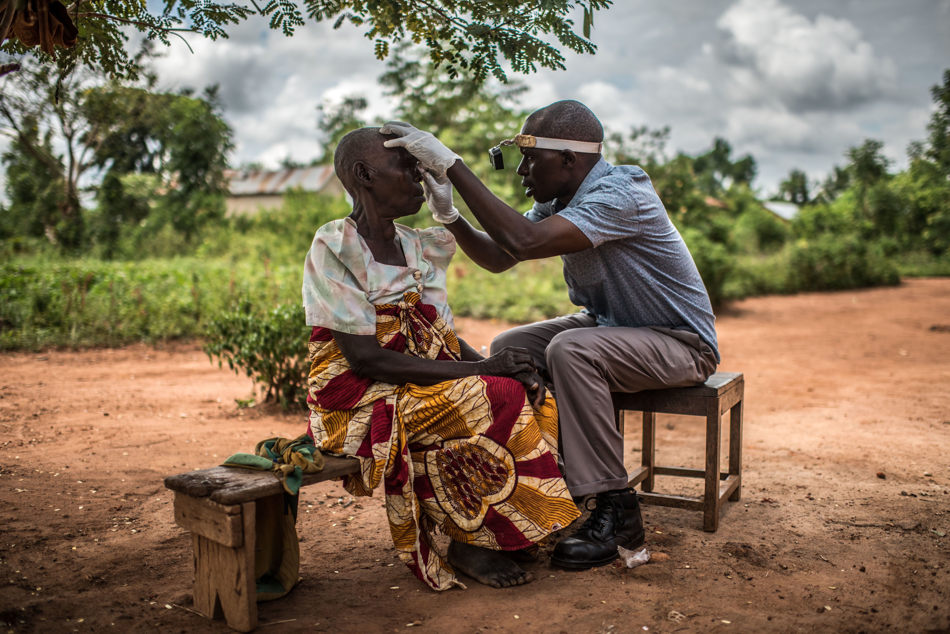


Document management in ProMIS
© CBM / Trenchard

Slide 2
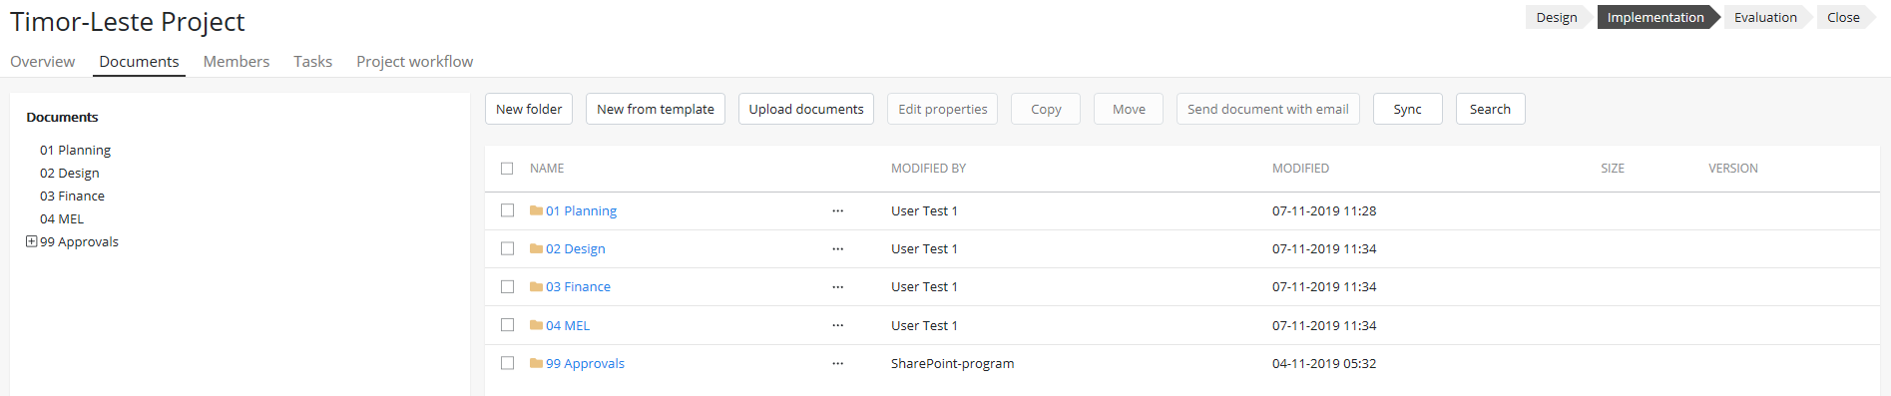
Documents tab
The Documents tab provides a space to store all the documents related to a page
Which buttons you see depends on whether you’re a Member of the page or not
Document button bar
Navigation tree
Folders
Document metadata

Slide 3
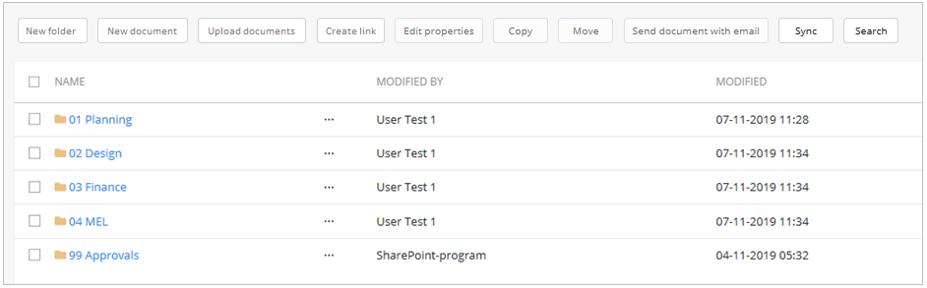
Standard folder structures and permissions
Different entities can have different standardised folder structures to make it easier to store and find documents across projects, teams, offices and locations
Even if you are a Member of the page, the top level of the folder structure is always locked to all users except Administrators (to maintain these standardised structures)
To upload or edit a document, click into one of the top-level folders and the buttons will be enabled
Document button bar at the top level of the folder structure

Slide 4
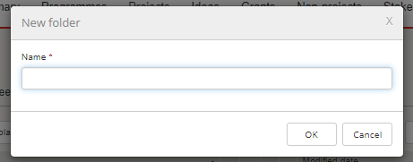
New folder
Document button bar
Click on ‘New folder’ to add a new folder to the level you are in
If the ‘New folder’ button is greyed out it means you do not have permission to add or edit folders at that level
Click into a folder instead and the button will become active
Fill in the form with the folder name and click OK

Slide 5
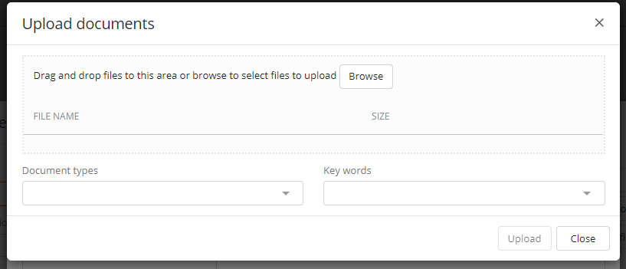
Upload documents
Document button bar
Use the ‘Upload documents’ button to upload documents to a page or form.
Documents will by default upload into the folder you are in when you click ‘upload’
There are two ways to upload documents:
Click the ‘Browse’ button and select the document(s) to upload
Drag and drop the document(s) into the grey ‘Filename’ box (a dotted line will appear around it).
Add metadata (i.e. document types and tags). If uploading multiple documents, the same metadata will be associated to every document.
Select documents
Drag and drop

Slide 6
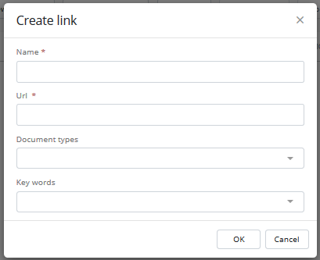
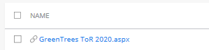
Create link
Document button bar
The ‘Create link’ button enables links to files in other areas of the system or other locations, or websites to be linked to
Click on ‘Create link’ and a form will appear
Fill in the details and Click OK
The link will appear with a ‘link’ icon to show it’s a link, not a normal file

Slide 7
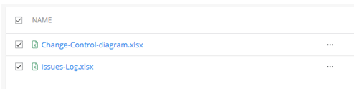
Edit properties – Multiple files
Document button bar
The Edit properties on the Document tab allows you to edit multiple documents at once
Use the checkboxes to the left of the file name to select multiple documents, the ’Edit proprties button will then become active
Click the ‘Edit properties’ button
Edit the properties and click ’OK’
The same properties will be applied to all selected documents
Any previous properties will be overwritten with the new properties
The Edit properties on the File context menu tab allows you to edit a single documents at once. This is covered in a later section.

Slide 8
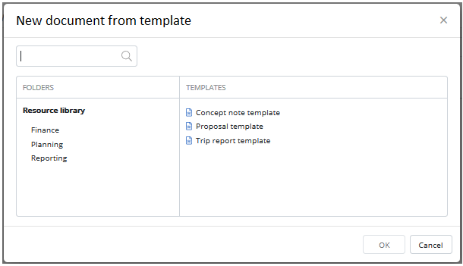
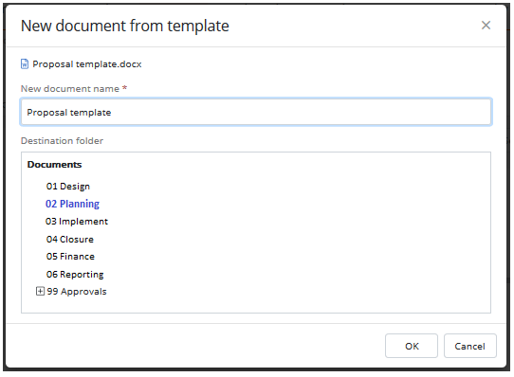
New document (from Template)
Document button bar
Users can access the document templates in the Resource library by clicking on the ‘New document’ button
The Resource library folders will appear. Navigate to the template required and click OK
Rename the file (it is a copy of the template). When saving, the folder you clicked the ‘New document’ button from will be the default, but the user can also navigate to a different folder if required. Click OK
The new document will be created.
Navigate the folders in the Resource Library to find the template
Rename the file and check the correct folder is selected

Slide 9
Copy or Move documents
Document button bar
You can copy and move documents within the page’s folders or to other pages (as long as you are a Member of the destination page)
Use the checkboxes to the left of the file name to select multiple documents, both the Copy’ and ’Move’ button will become active
Click the required button
Select the desination folder and click ’OK’
When copying, only the latest version will be copied and the versioning will restart from 1.0 (i.e. the copy will not copy the version history of the original).
When moving within the same entity, the full version history is retained. When moving to a different entity, only the latest version is moved.

Slide 10
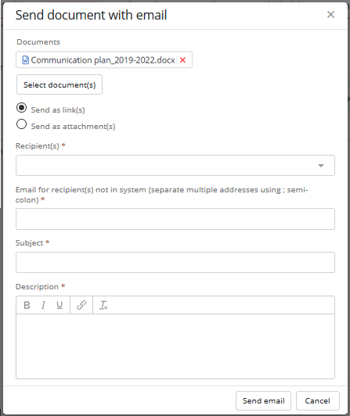
Send document with email
Document button bar
You can send documents via email to fellow NGO Online users or to external email addresses
Select whether to send the document(s) as a link or an attachment (note: links to documents will only work for NGO Online users)
The sender will receive a copy of the email as confirmation that the documents were sent
Choose whether to send the file as a link or attachment
Select a user from the system or enter an external email address

Slide 11
Syncing documents & working offline
Document button bar
When you are not connected to the internet you cannot access NGO Online, but you can access the folders and documents if they have been synced to your computer.
Syncing required Microsoft’s One Drive for Business to be installed on your computer.
Syncing is by page (not the whole system) and you select the pages you want to sync by clicking the ‘Sync’ button
Once you have synced a folder structure, that folder will keep updating automatically until the internet connection is interrupted and will resync when the connection returns.
Tip: Check your folders have been synced properly before you interrupt the connection. You don’t want to find out when you go to access your files offline they were not fully synced.
If a user is having issues with this function, talk to your IT department to check you have Microsoft’s One Drive for Business installed. This function cannot work without it

Slide 12
Search
Document button bar
This search looks for documents within the page you’re on only
It includes folders and files
It looks for text within the filename and folder name (i.e. not the content)
To search on all documents in the system or to use a more advanced search with filters use the Search page (accessible in the Top bar)

Slide 13
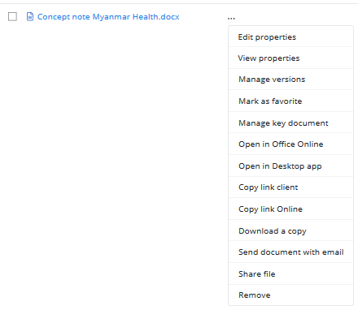
Document context menu (…) functions
Document context menu (…)
Options appear when the user clicks on the Document context menu

Slide 14
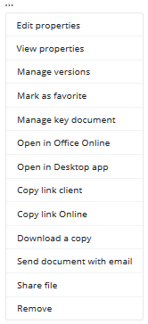
Edit and View properties – Single files
Document context menu (…)
The Edit properties option in the Context menu tab allows you to edit properties for a single file
On the relevant file, click on the Context menu (...) and select ’Edit properties’
Edit the properties and click ’OK’ to save the changes and close the form
The Edit properties button on the Document tab bar allows you to edit a multiple documents at once. This is covered in an earlier section.
The View properties option in the Context menu tab allows you to view properties for a single file
On the relevant file, click on the Context menu (...) and select ’View properties’
View the properties and click ’OK’ to close the form

Slide 15
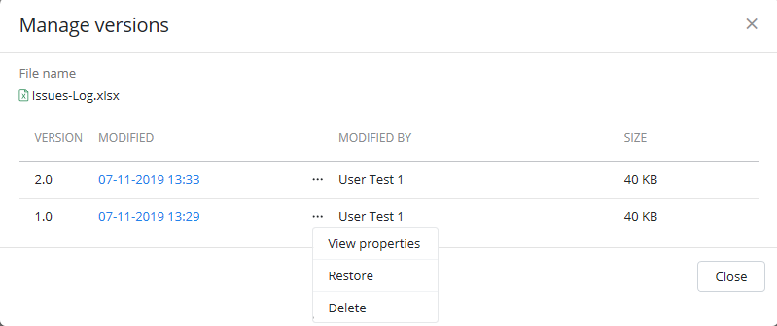
Manage Versions
Document context menu (…)
Versions are created when the properties of the document are updated or when you save and exit a Microsoft Office application (i.e. Word, Excel, PowerPoint).
On the relevant file, click on the Context menu (...) and select ’Manage versions’
A pop up will appear listing the current and prior versions along with modified date and modified by
Use the context menu (...) next to the relevant version to View properties, Delete it, or Restore it to the latest version
Shows all previous versions of the document

Slide 16
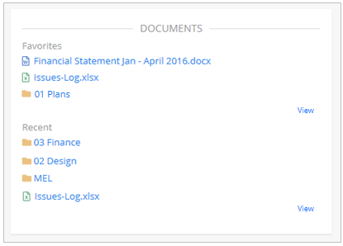
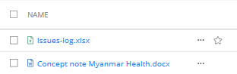
Favourite documents
Document context menu (…)
Favourite documents are user-specific (only you can see your Favourite documents) and they appear on your Start page for quick access.
When a document or folder is made a ’Favourite,’ a star icon appears to the right of the document or folder name and a link is created on the user’s start page.
Favourites appears in the ‘Documents’ box on your Start page
Click on ‘View’ to see more information
Star icon appears next to the document or folder name

Slide 17
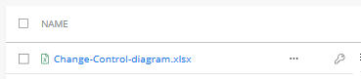
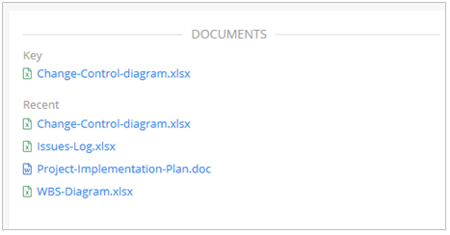
Key Documents
Document context menu (…)
Key documents are page-specific (any user can see Key documents) and they appear on the Overview tab Documents box of the selected page for quick access.
This is usually used for important or regularly used documents
A document can be a Key document on the page the document is stored on or on any other page (as long as you’re a Member of the destination page).
Key documents appear with a key icon to the right of the document name.
Key documents appear in the ‘Key documents’ box on the Overview tab
Key icon appears next to the document or folder name

Slide 18
Open in Office Online
Document context menu (…)
This opens the file in Office Online (e.g. Word Online, Excel Online) instead of the desktop version
It is recommended that any users working on Macbooks use this option

Slide 19
Open in Desktop app
Document context menu (…)
This opens the file in the Desktop application.
It is useful if the organisation’s default set up opens in Office Online

Slide 20
Copy Link
Document context menu (…)
You can send a link to a document in NGO Online to another NGO Online user via the ’Copy link’ function.
Clicking ’Copy link’ will copy the URL of the document to your clipboard
Once copied, go to the place you want to paste the link (eg an email or document) then click paste or press Ctrl and V on the keyboard to paste the link
’Copy link Desktop app’ option copies a link that when clicked will open the file in the Desktop application
’Copy link Office Online’ option copies a link that when clicked will open the file in Office Online

Slide 21
Download a copy
Document context menu (…)
There may be occasions when a copy of a file needs to be downloaded, this function allows that
The downloaded file will be stored in the local computer’s download folder

Slide 22
Send document with email (single)
Document context menu (…)
This function is available in the document context menu so it can be used for a single file.
It uses the same function that was covered in more detail in the Document button bar section, please refer there for more information (link here)

Slide 23
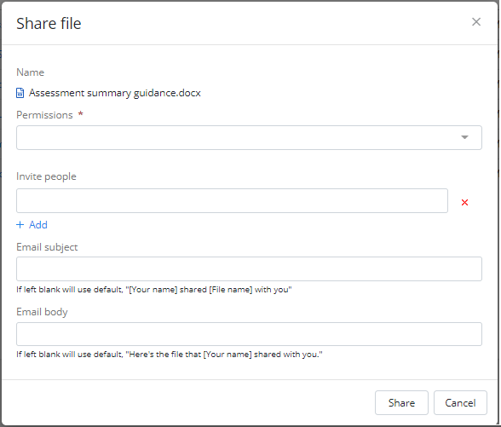
Share file/folder
Document context menu (…)
This function allows files and folders to be shared with people outside the organisation (i.e. who do not have access to NGO Online) via a link
To access the link, the receiver must have a Microsoft account (e.g. an Office365 or a Google account)
When creating the link, select the permission level the receiver should have for the file or folder
Edit link: The receiver has full edit access to the file(s)
View link: The receiver can only view the file(s)
When the receiver clicks on the link, they will only be able to see the file or folder shared with them in a browser view – they will not be able to access NGO Online or any other information.

Slide 24
Remove file/folder
Document context menu (…)
Files and folders can be removed (i.e. deleted) by clicking on this option
Once removed they will be available in the recycle bin for 90 days (see later slide on details regarding the Recycle bin)

Slide 25
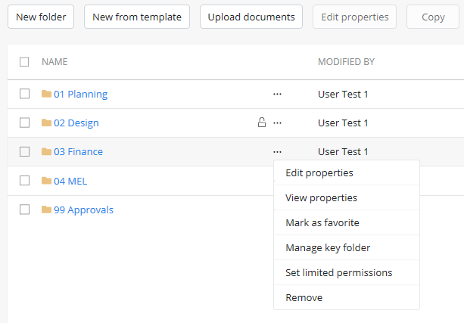
Set limited permissions
All Standard Users have read-only access to all pages and documents in the system by default.
You can limit who has edit and read access for a particular folder (not an individual document) via the ’Set limited permissions’ function.
A padlock icon will appear next to folders that have limited permissions set (if you have permission to see the folder).
Permissions can be re-set to default via the ’Reset permissions’ option.
An open padlock means the folder has permissions set and you have edit access.
A closed padlock means the folder has permissions set and you have read-only access.
If you don’t have read or edit access to a folder, the folder will not be visible to you.

Slide 26
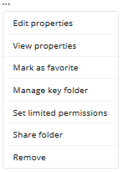
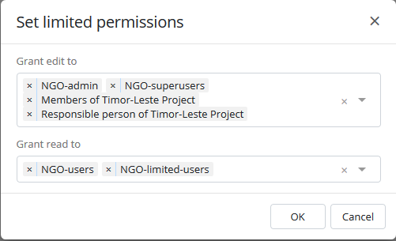
Set limited permissions
Folder context menu (…)
Members of [page name]: Any user who has been added to the page as a Member
Responsible person of [page name]: The user selected as the ‘Responsible person’ for the page
NGO-limited-users: Any user who is in NGO Online set up in the role of ‘Limited user’
NGO-users: Any user who is in NGO Online set up in the role of ‘Standard user’
NGO-superusers: Any user who is in NGO Online set up in the role of ‘Super user’
NGO-admins: Any user who is in NGO Online set up in the role of ‘Administrator’
Individual users can also be added by selecting their name from the drop-down
Users or groups who can edit the documents within the folder
Users or groups who can read the documents within the folder (but not edit)

Slide 27
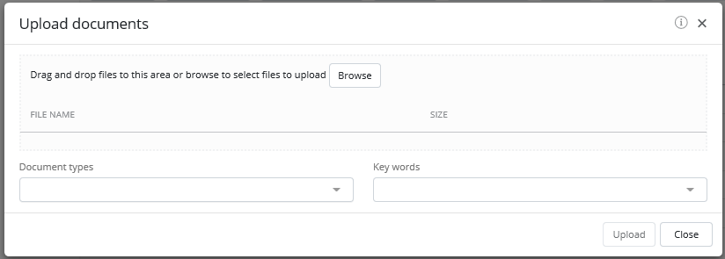
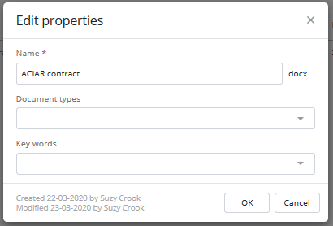
Document metadata
Document metadata refers to the Document types and Keywords that are editable by a user when a file is uploaded, or properties are edited.
Document types are a set list defined by the organisation to help identify and search for documents
Keywords are words or short phrases that can be used to associate documents and can help with searching.
This isn’t a set list, users can select an option already available or add a new option by typing the new keyword in the field and clicking ‘Add item “[typed text]”. The new option will now appear in the list for all users.
Users should check the list of Keywords available for any similar options before adding a new one to avoid duplication (for example Maternal Health, MNCH or RMNCH).

Slide 28
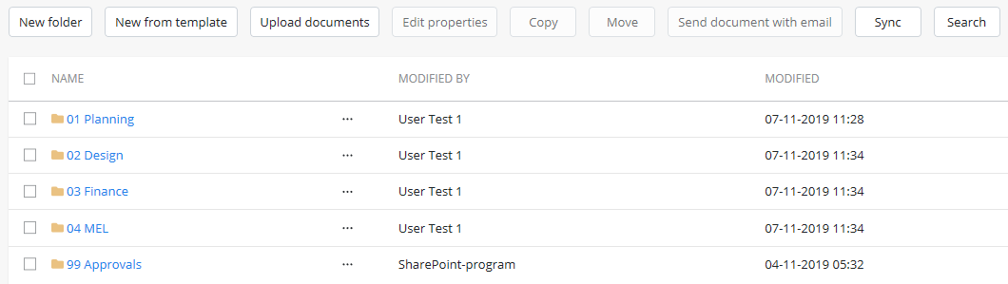
'99 Approvals' folder
The ’99 Approvals’ is a system-generated folder that automatically captures approvals
When an approval is completed, the system automatically takes a screenshot of the approval and saves it into this folder
A read-only copy of any documents attached to the task when it was approved are also saved into this folder (to show the version of the document at the time it was approved)
Users cannot upload documents to this folder.

Slide 29
Collaboration
In Microsoft Word, Excel and PowerPoint:
You can compare different versions
Multiple people can edit at the same time
In Word, changes are highlighted in green

Slide 30
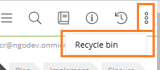
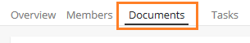
Recycle bin
The Recycle bin is available on all pages and can be accessed by any page member
It is specific to the page library (i.e. the Project page for ‘Cambodia MNCH’ has its own recycle bin; the Grant page for ‘DFID Grant 2018’ has it’s own recycle bin etc)
It is accessed by clicking on the Toolbox settings (three dots) in the top right from the Documents tab and clicking ‘Recycle bin’
It holds files and folders that have deleted for 90 days, allowing any user of the page to restore the file(s) or folder(s) back to their original folder location
(If a file has been deleted over 90 days ago and needs to be restored, contact Precio to look into it.)

